Slide 1





SMART INDIA HACKATHON 2026
HARDWARE EDITION | MINISTRY OF EDUCATION & QUALCOMM INC.
PROJECT PHOENIX X
SAR UAV
Dual-Brain Edge-AI Scout for Zero-Infrastructure Disaster Reconnaissance
PROBLEM STATEMENT ID
THEME
SIH26177
Robotics and Drones
PROBLEM STATEMENT TITLE
A deployable AI-powered autonomous drone that aids search-and-rescue operations by detecting people and hazards, thereby improving responder safety and reducing victim discovery time.
SPONSORING ORGANIZATION
CATEGORY
Qualcomm Inc.
Hardware
Qualcomm Dragonwing QRB2210
TEAM NAME
TEAM ID
Phoenix X
141943
STM32U5 Zephyr RTOS Flight
Dual RGB + Thermal Fusion
WEB DEMO
VIDEO
3-5 km LoRa Telemetry
IEEE Anti-Drift VIO Navigation

Slide 2

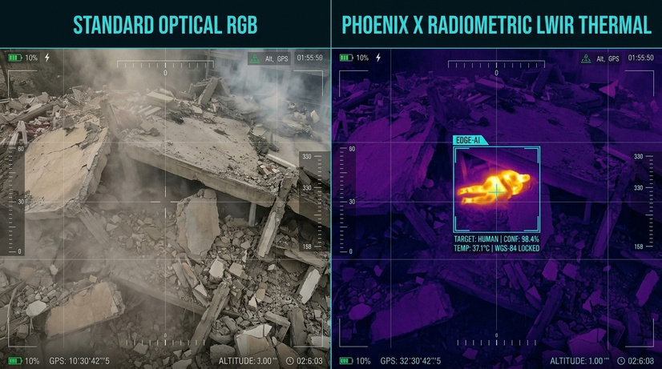





Disaster Reconnaissance & Emergency Survivor Triage
PROBLEM STATEMENT
PROPOSED SOLUTION
IN CATASTROPHIC DISASTERS (LANDSLIDES, EARTHQUAKES), FIRST RESPONDERS FACE FOUR CRITICAL BARRIERS:
COMMS BLACKOUT: Downed cellular towers & power grids; cloud-dependent drones rendered completely inoperable.
ZERO VISIBILITY: Mud slush, dense smoke, and darkness blind standard visual electro-optical cameras.
ENTRAPMENT ACCESS: Survivability sharply declines with delayed response; manual foot searches cannot cover wide rubble sectors in time.
RESPONDER HAZARDS: Ground teams advance blindly toward fallen electrical wires, gas leaks, and secondary landslides.
Project Phoenix: An autonomous, field-deployable multirotor scout engineered for offline disaster zones:
100% ONBOARD EDGE COMPUTE: Heterogeneous AI (CPU/GPU/DSP) executes all vision & geolocation on-device; zero cloud/cellular dependency.
MULTI-SPECTRAL FUSION: Combines 4K RGB with LWIR Thermal (8-14μm) to spot surface heat anomalies & exposed casualties through smoke/darkness.
TAIT-BRYAN RAY-CASTING: Calculates victim ground GPS coordinates on the fly from altitude without battery-wasting hovering.
LIGHTWEIGHT OFFLINE GCS: Low-power field tablets receive 17-byte pins; charts priority triage queues & safe walking corridors [1].
INNOVATION / UNIQUENESS
Dual-Brain Architecture
5W Edge YOLO
Ray-Cast Geolocation
ROS-LoRa P2P Bridge
Anti-Compass Drift VIO
Arduino UNO Q (4GB LPDDR4 / 32GB eMMC): Qualcomm Dragonwing QRB2210 MPU + STM32U585 MCU on a unified 40g board.
Heterogeneous On-Device AI: CPU/Adreno GPU/Hexagon DSP executes INT8 YOLO vision; draws ~3.5W under peak inference.
Tait-Bryan Ray-Casting: Converts camera ray & ToF laser altitude to ground GPS pins on the fly without hovering.
Resilient LoRa P2P Telemetry: 17-byte bit-packed telemetry stream over 3–5+ km in blackout zones (Souli et al. [3], 2024).
Anti-Compass Drift VIO: Visual-Inertial Odometry overrides magnetometer in collapsed steel rubble (IEEE standard navigation).
TRADITIONAL DISASTER SEARCH
(Current Approach)
Manual Foot Sweeps
Blind Rubble Digging
Stalled at Sunset (Darkness)
High Responder Casualty Risk
Critical Hours Lost
PHOENIX AUTONOMOUS SAR
(Our Approach)
Autonomous Aerial Sweep
24/7 Thermal Night Vision
Instant Survivor GPS Raycasting
Zero-Drop LoRa Telemetry
Safe Responder Path Routing
PROJECT PHOENIX: Autonomous Multi-Spectral Edge-AI UAV | SIH26177 (Qualcomm Inc.)
2
Notes:
2

Slide 3
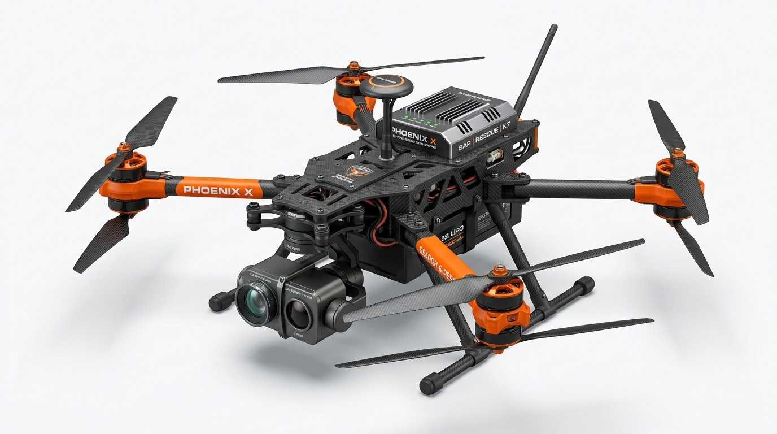
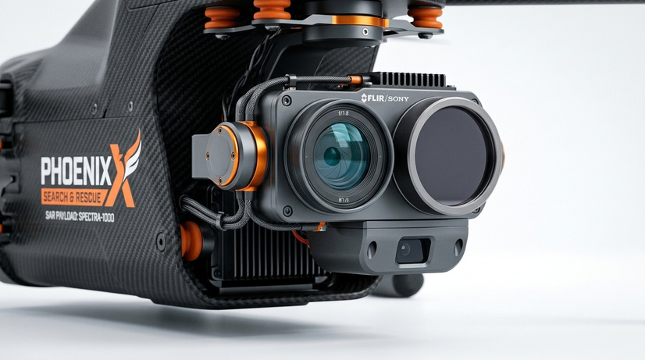
TECHNICAL APPROACH
Dual-Brain Architecture & Workflow
IMPLEMENTATION WORKFLOW
SYSTEM ARCHITECTURE
Sector Partition & Launch
Dual-Brain Hardware Split (Arduino UNO Q):
1
Operator selects 2 km² search polygon on offline tablet; UAV launches in < 3 minutes.
Real-Time MCU (STM32U585 / Zephyr RTOS):
  250 Hz (4ms) deterministic flight stabilization loop
  350 Hz PWM direct brushless motor control
  IMU (MPU6050) + Barometer (MS5611) + Downward LiDAR
2
Autonomous Grid Sweep
Boustrophedon decomposition with 60% sidelap & 70% overlap; ToF altimeter maintains constant GSD over sloped terrain.
Asynchronous non-blocking RPC bridge
3
Multi-Spectral Perception
Mission Computer (Qualcomm Dragonwing QRB2210 / Linux):
Dual 4K RGB + LWIR Thermal fusion; edge YOLO detects survivor heat anomalies (37°C) & flags surface obstacles for flight avoidance.
  Qualcomm Dragonwing QRB2210 (Debian Linux — 4GB RAM, 32GB eMMC)
Heterogeneous On-Device AI (CPU/GPU/DSP) // Ray-Caster // SX1262 LoRa Driver [3]
4
Ray-Cast Geolocation
Transforms 2D bbox offset via 3D Tait-Bryan DCM matrix & ToF altitude (ΔP = H_AGL · R·v) to pin GPS on the fly.
TECH STACK
5
Binary LoRa Packet Burst
Onboard Triage & LoRa Burst: UAV computes victim priority on-chip & packs coordinates into 17-byte binary frame [3]; broadcasts over 868 MHz.
Flight Stack
Zephyr RTOS, YMFC-32 Core, PX4 Autopilot
Edge AI & Vision
YOLOv8n INT8 (Detection & Avoidance), SNPE SDK, ONNX, OpenCV
GCS Triage & Route Planning
Robotics Middleware
ROS2 Humble, MAVLink v2, micro-ROS
6
Long-Range RF Comms
Semtech SX1262 LoRa P2P (868 MHz)
Lightweight Offline GCS: Low-power tablet receives 17-byte pins; charts hazard-aware Dijkstra safe walking corridor [1] avoiding live electrical lines.
Tactical GCS
React, Leaflet, Tailwind CSS, WebSockets
Security
HMAC-SHA256 Telemetry Packet Signatures
PROJECT PHOENIX: Autonomous Multi-Spectral Edge-AI UAV | SIH26177 (Qualcomm Inc.)
3
Notes:
3

Slide 4






FEASIBILITY AND VIABILITY
Feasibility, Challenges-to-Strategies & Market Viability
FEASIBILITY
VIABILITY
CHALLENGES → STRATEGIES
TECHNICAL FEASIBILITY
ECONOMIC VIABILITY
Prototype cost: <40,000₹
1
Comms Blackout in Canyons
  Propulsion Sizing: 38% battery mass fraction, β ≥ 2.0 thrust-to-weight ratio.
All-Up-Weight: 1.58 kg mass budget (Comfortably under DGCA 2.0 kg Micro Category).
Sub-6W Electronics Payload: Onboard compute draws ~5.5W under peak AI (>96% power for flight).
→ Strategy: 868MHz LoRa packet bridge in NLoS canyons [2] (Pérez-Díaz-de-Cerio, IEEE Access 2026, DOI: 10.1109/ACCESS.2026.3731317).
Enterprise Drone Disruption costs:
2
Smoke, Mud Slush & Darkness
DJI Matrice 30T
₹10+ Lakhs
Phoenix
₹1.2 Lakh
→ Strategy: 8-14μm LWIR thermal anomaly detection in dense smoke & fog [1] (Siotia et al., IEEE Access 2026, DOI: 10.1109/ACCESS.2026.3730315).
OPERATIONAL FEASIBILITY
  Fleet Scalability: NDRF battalions can deploy a swarm of 5 Phoenix UAVs for the price of 1 commercial drone.
3
Rubble Steel Magnetometer Distortion
  Setup Time: < 3 minutes from rugged backpack unboxing to flight.
Quick-Swap Battery: Dual 4S LiPo tray for continuous sortie coverage.
Zero Ground Compute Burden: 100% onboard processing enables deployment via low-power tablets or handheld LoRa pagers.
→ Strategy: Visual-Inertial Odometry overrides magnetometer in collapsed steel rubble (IEEE standard navigation).
NATIONAL DATA SOVEREIGNTY
  100% Air-Gapped: Zero telemetry leaked to foreign cloud servers; adheres to Indian Defense & Home Ministry cyber norms.
4
Propeller Vibration Sensor Noise
FINANCIAL FEASIBILITY
→ Strategy: Notch-filtered EKF & silicone harmonic vibration dampening (IEEE Control Systems & Robotics).
  Prototype Build: ₹37,400 (Calibrated Prototype — Arduino UNO Q 4GB/32GB).
Production BOM: ₹85,000 – ₹1,20,000 per unit (10x cheaper than commercial enterprise drones).
DEPLOYMENT ECOSYSTEM
  Seamless integration into state disaster management authorities (NDRF, SDRF, Indian Army disaster columns).
5
Actuator Saturation in Gusts
→ Strategy: Anti-windup integrator clamping on 250Hz deterministic PID loop (IEEE Industrial Electronics).
PROJECT PHOENIX: Autonomous Multi-Spectral Edge-AI UAV | SIH26177 (Qualcomm Inc.)
4
Notes:
4

Slide 5




IMPACT AND BENEFITS
Mission Impact & Multi-Stakeholder Benefits
TRAPPED VICTIMS
NDRF / SDRF TEAMS
DISASTER AUTHORITIES
DISTRICT GOVERNANCE
  Located in Golden 72h window
  Discovered through mud & debris
  Rapid medical triage prioritization
  Maximized chances of survival
  Advance hazard mapping
  Avoid live cables & gas leaks
  Automated safe-route navigation
  Reduced physical rescuer fatigue
  Unified local tactical map
  Real-time survivor count & coords
  Zero dependency on cell towers
  Dynamic search sector logging
  Efficient resource allocation
  Targeted airlift & medical drops
  Post-disaster audit trails
  Affordable procurement at scale
IMPACT PIPELINE
1 DEPLOY
2 SEARCH
3 LOCATE
4 RESPOND
5 OUTCOME
PHOENIX DOES
Backpack to flight with no infrastructure
Flies an autonomous sweep with RGB + thermal vision
Pins each detected survivor with GPS coordinates
Ranks survivors and plots a hazard-free route
Delivers all this at a fraction of enterprise-drone cost
IMPACT
Search starts within minutes of arrival
Search continues at night and in smoke or fog
Rescuers go straight to survivors, not digging blind
Crews avoid cave-ins, gas leaks and live cables
More survivors reached in the Golden 72 hours
MEASURE
< 3 min
2 km²
0 cell towers
Ranked queue
₹1.2 Lakh
unboxing to flight
search sector
needed to report locations
+ safe rescue route
vs ₹12-14 Lakhs
PROJECT PHOENIX: Autonomous Multi-Spectral Edge-AI UAV | SIH26177 (Qualcomm Inc.)
5
Notes:
5

Slide 6



RESEARCH AND REFERENCES
Academic Research Foundations & Prototype Verification
RESEARCH & REFERENCES
PROTOTYPE PROOF
01
IIT Jodhpur & Manipal (IEEE Access, Sept 2026) [1]
OPEN-SOURCE REPOSITORY & VERIFICATION ASSETS
  • 'SwarmSAR-FW: Drone-Based Swarm Search and Rescue in Fire and Water Disasters'
• Sourced & validated Hazard-Aware Safe Access Ingress Routing for ground crews & 98.7% triage.
DOI: 10.1109/ACCESS.2026.3730315 (Direct IEEE Document Link)
Video link: SIH Grand Finale Submission Portal
Presentation Video:
02
UPC Spain & Souli et al. (IEEE Access 2026 / Elsevier 2024) [2, 3]
Web Demo:
Github Repo:
  • 'Long-Range BLE Detection via Drone LoRa Relays' [2] & 'Mission-Critical ROS-LoRa Architecture' [3]
• Sourced 868 MHz LoRa off-grid data bridge & 17-byte binary telemetry in cellular blackout zones.
DOIs: 10.1109/ACCESS.2026.3731317 [2] | 10.1016/j.comcom.2024.04.015 [3]
phoenix-sar-uav.vercel.app
github.com/jvstin47/Phoenix-SIH26177-SAR-UAV
Documented Subsystems:
03
TalTech Estonia & SARDO (IEEE Access 2023 / IEEE TMC 2022) [4, 5]
1. docs/research_papers_synthesis_2026.md
2. docs/prototype_bom_and_financial_viability.md
3. docs/ros_lora_mission_critical_uav_swarm_research.md
4. docs/bouabdallah_quadrotor_research_findings.md
  • 'Applying RIS-Based Comm for Collaborative Computing' [4] & 'SARDO RF Victim Localization' [5]
• Validated decentralized swarm edge-computing without cloud servers (-32% energy); 1/8th weight vs SDR.
DOIs: 10.1109/ACCESS.2023.3293737 [4] | 10.1109/TMC.2022.3168331 [5]
Prototype Architecture Deliverables:
BITS Pilani & van Tilburg (Elsevier 2020 / Wilderness Med 2017) [6, 7]
Live Web GCS Tactical Dashboard (React + Leaflet)
04
Multi-Spectral Dual Stream (RGB + LWIR Thermal HUD)
  • 'Drone Surveillance & Human Action Detection' [6] & 'First Report of Using Drones for SAR' [7]
• Validates 2000+ aerial human detection dataset for INT8 YOLO and operational field unboxing protocols.
DOIs: 10.1016/j.comcom.2020.03.042 [6] | 10.1016/j.wem.2017.06.004 [7]
LoRa 17-Byte Binary Bit-Packing Serialization Module
Ray-Casting Geolocation Python Engine
PROJECT PHOENIX: Autonomous Multi-Spectral Edge-AI UAV | SIH26177 (Qualcomm Inc.)
6
Notes:
6

